Slide 1

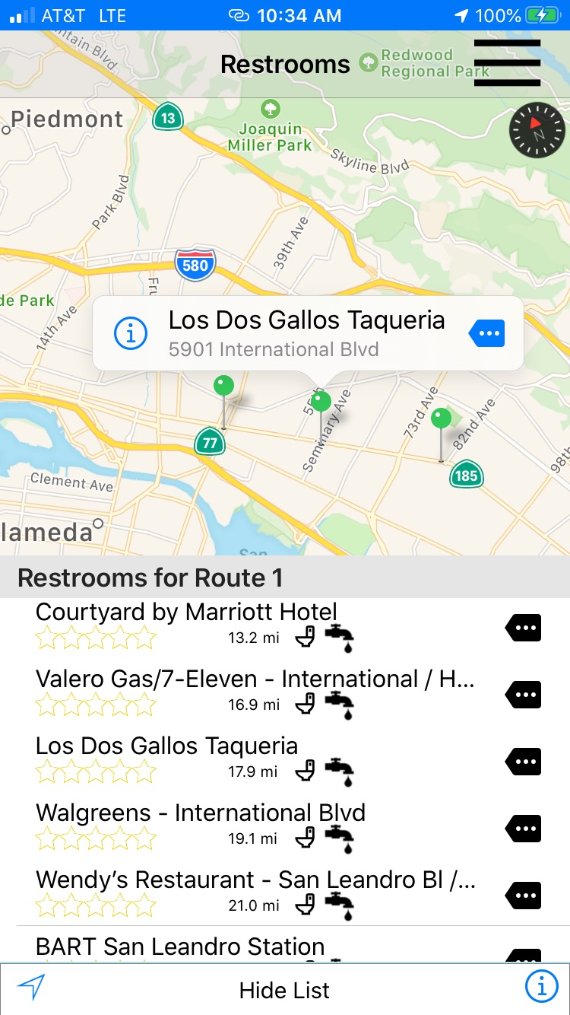
Restroom Finder 2 July 2020
What’s New
AC Transit

Slide 2
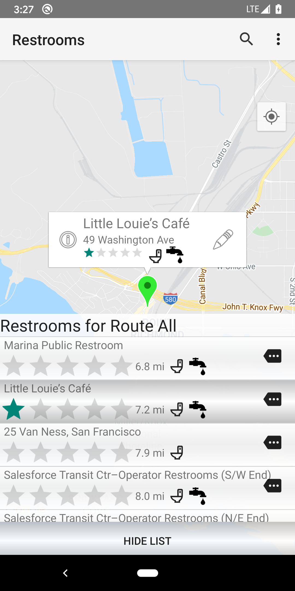

History
Restroom finder is the GPS-enabled mobile app that pinpoints the nearest authorized restroom for operators and field staff based on their location. In addition to providing location information employees using the app, employees can give feedback on the cleanliness and adequacy of each restroom.
Software suite includes:
Phone App (iOS 11+/Android 5.0+)
Administration Website (Mobile friendly)
Reports (Feedback and Resolutions)
Operator Paddle Restroom Book
OCC CleverCAD Map Layer
In Service for 4 years, with over 9000 feedbacks from 350 installs.
Covid-19 has prompted need for new features to fulfill OSHA requirements.

Slide 3
Recovery & Restoration of COVID19
Operator Restroom Finder is currently in use by the District Operators, Road Supervisors, and Operation Control Center staff. Since the COVID19 situation, it has been a challenge for the operators to locate the restrooms as most of the businesses are closed.
New enhancements to the restroom software were set in motion to improve finding restrooms for our operators.

Slide 4
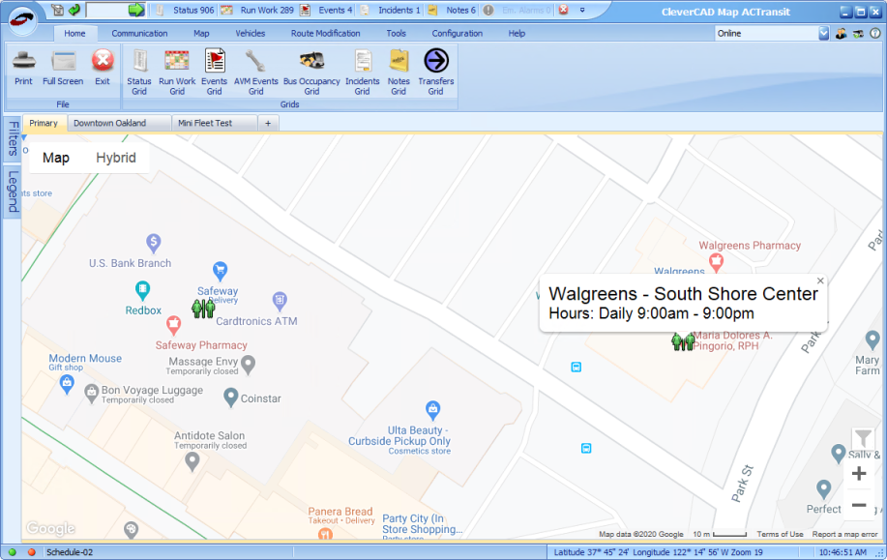
Recovery & Restoration of COVID19
CleverCAD Restroom map layer for OCC

Slide 5
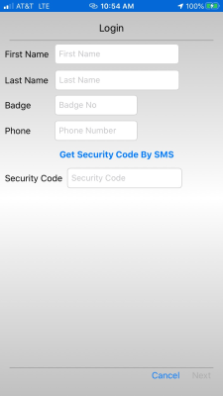
Recovery & Restoration of COVID19
Improved security with SMS phone number verification during login process

Slide 6
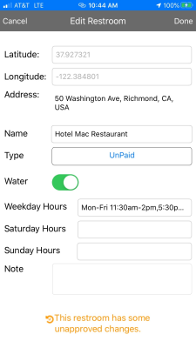
Recovery & Restoration of COVID19
Inside the app, supervisors can
Add new restrooms on the map (long press at map position)
Edit existing restrooms

Slide 7
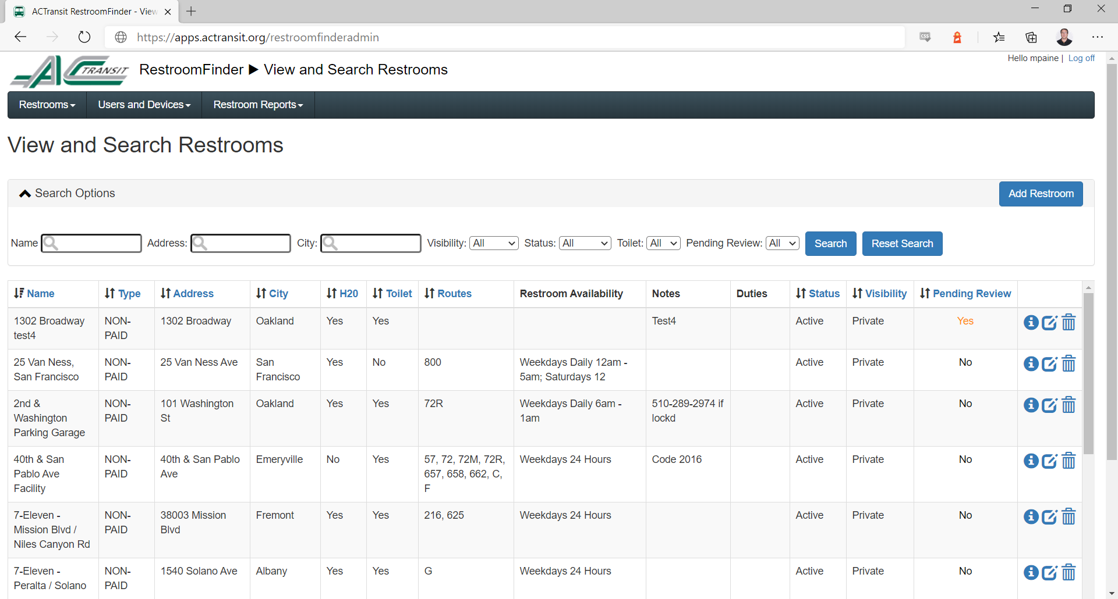
Recovery & Restoration of COVID19
Improved restroom administration features

Slide 8
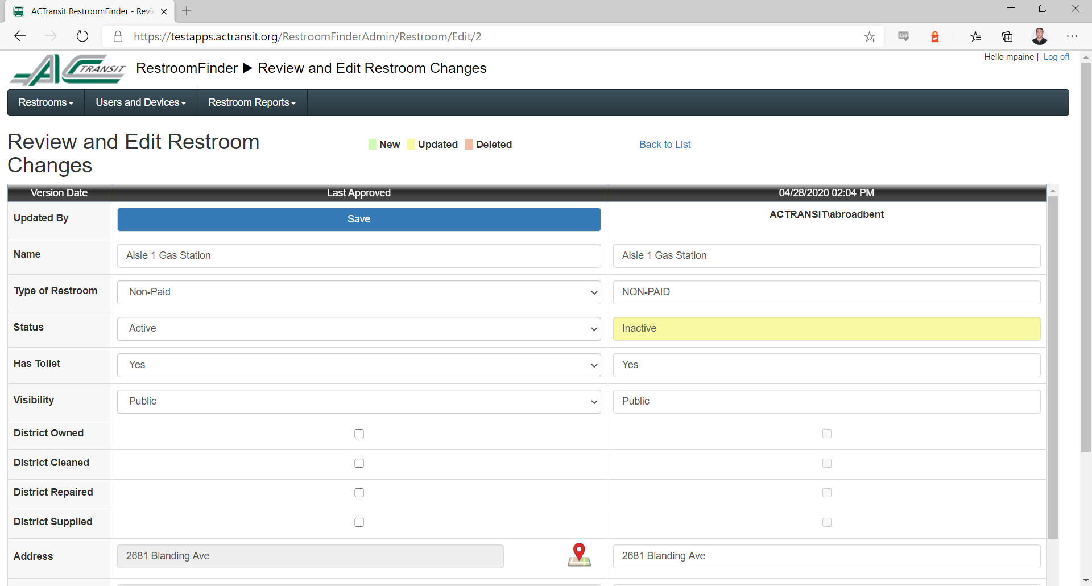
Recovery & Restoration of COVID19
Review and Edit Restroom Changes from Supervisors…

Slide 9
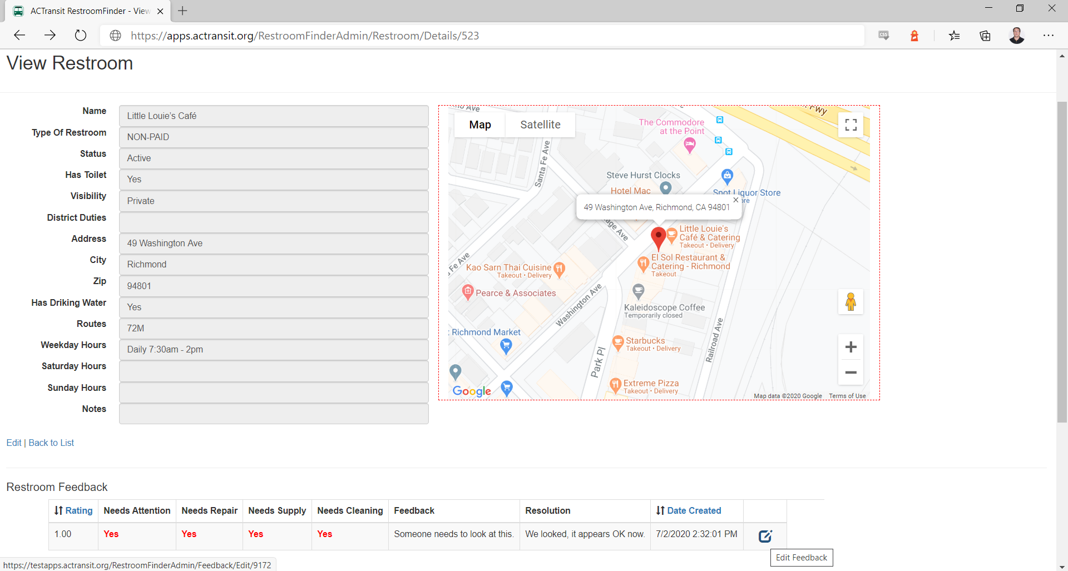
Recovery & Restoration of COVID19
Enter Resolutions to Restroom Feedback…

Slide 10
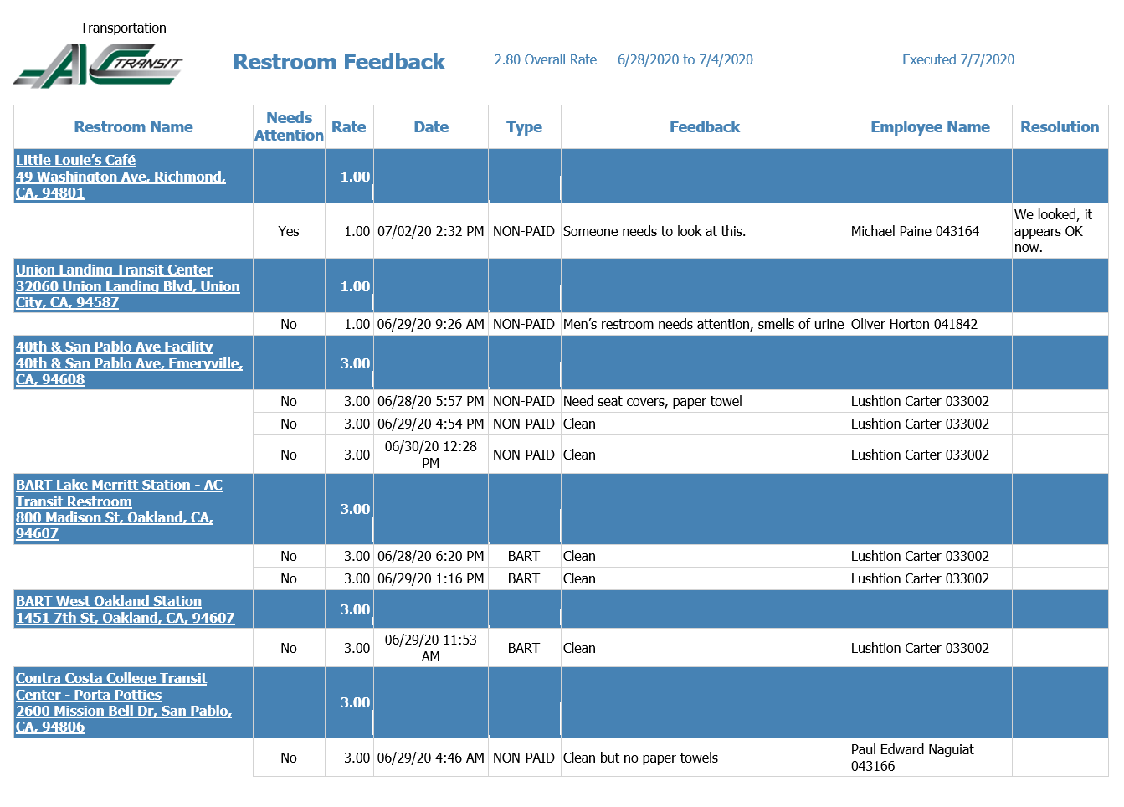
Recovery & Restoration of COVID19
Feedback Resolution now in Daily Report…

Slide 11
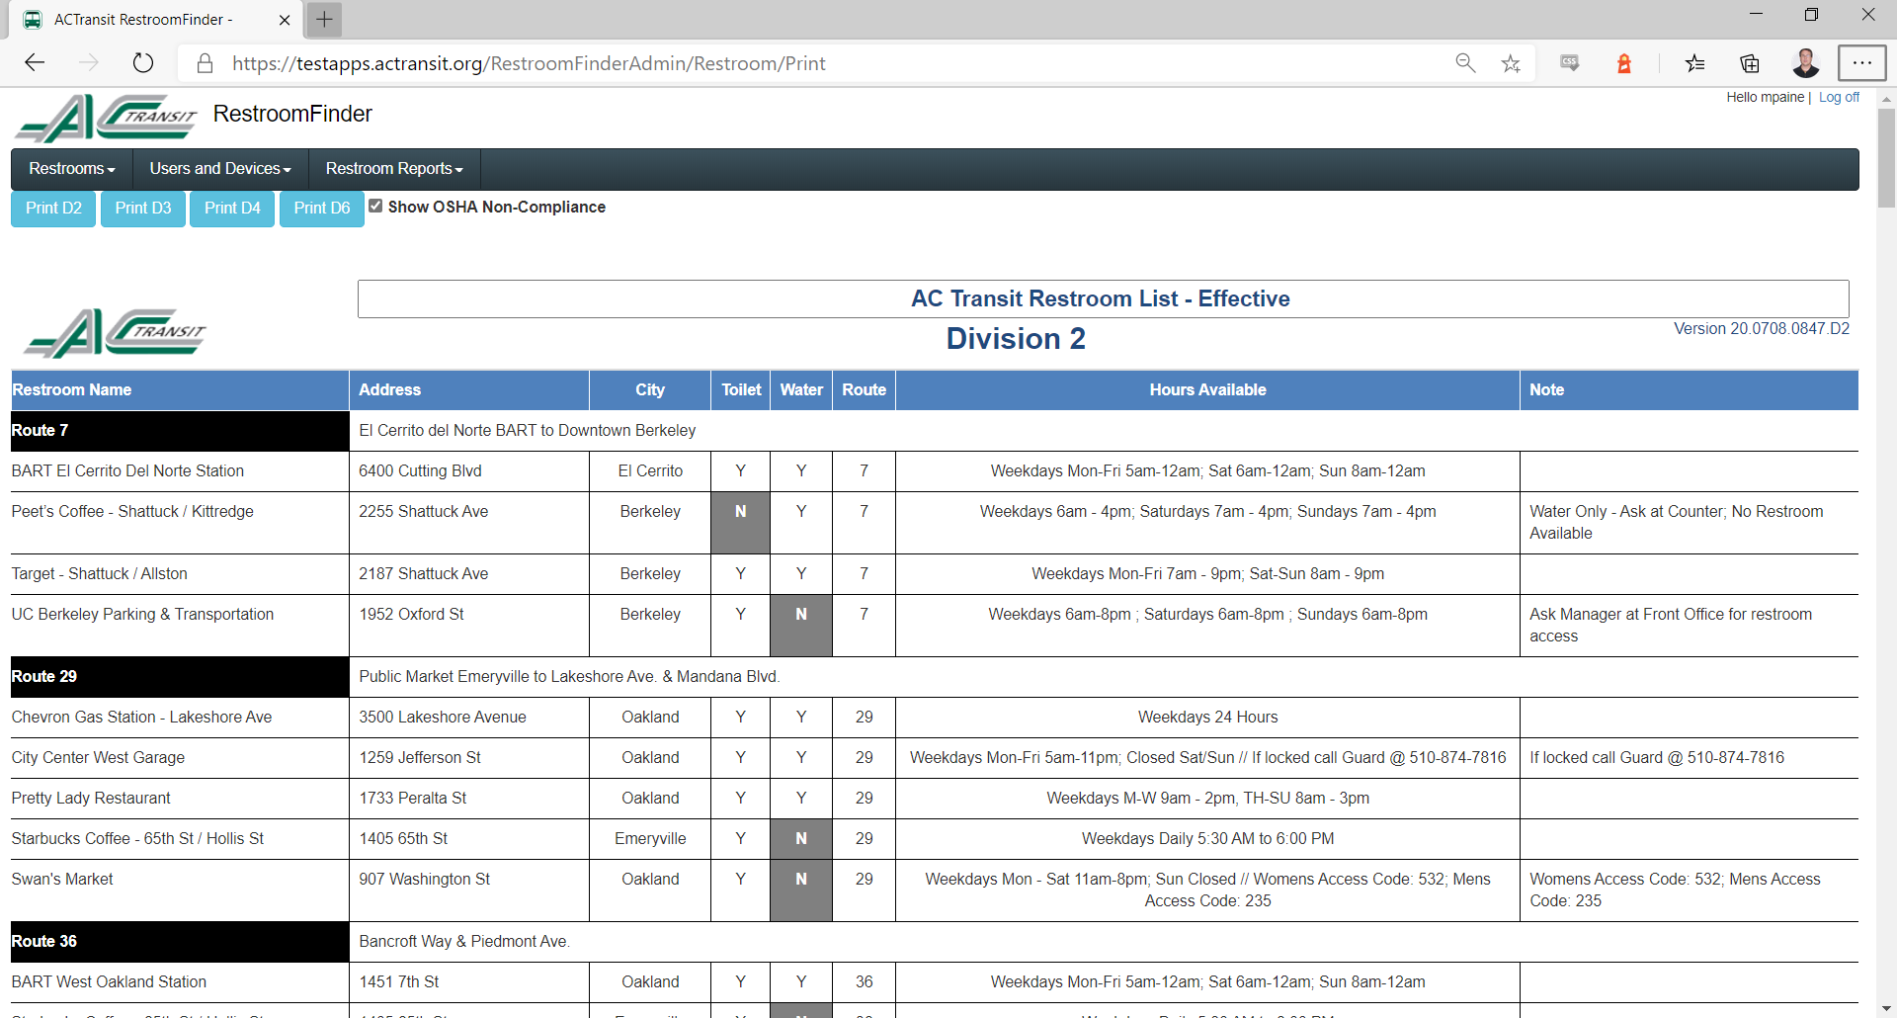
Recovery & Restoration of COVID19
Restroom Paddle Book (on demand)…

Slide 12
Other New Features
App: https://apps.actransit.org/mobile
Added support for Water only locations.
Added support for Dark mode (iOS only).
Added hourly and manual restroom refresh.
Show more information and restroom hours based on type of the day (Weekdays, Saturdays and Sundays)
Administration Website: https://apps.actransit.org/restroomfinderadmin
Accessible outside AC Transit’s network
Mobile friendly interface
Restroom scope – public or private – in case we would like to show restrooms to users who are not logged into the App (potential App Store distribution)
Restroom status - Active/Inactive
Restroom deletion – is always soft delete, in case the data needs to be restored afterwards and for easier tracking in our database
Restroom history – allows keeping track of all the changes for any given restroom
Restroom ‘Has Toilet’ column – indicates if the restroom has a toilet available or it’s only for drinking water
Restroom ‘District Duties’ – Indicate what are the District responsibilities towards the restrooms: Cleaning, Repair, Supply and Owned
Review Search Restrooms: Additional columns to display, filter and sort by: Visibility, Status, Toilet and Pending Review, Duties
Restroom Paddle Book: This is a printable report showing restrooms by division and route that Andy Broadbent can potentially use when creating the booklets that are supplied to operators who keep on the bus for reference
Application Access Management: This is new section that allows admins to review, grant or remove access to users and their devices using the application (Manage Users, Manage Users and Devices, Manage Devices)
Improved Restroom Feedback Report: Allows reviewing restrooms that required some work from our Maintenance/Facilities department and their resolution to fix the issue. This will help keeping track of any work been done on the restrooms.

Slide 13
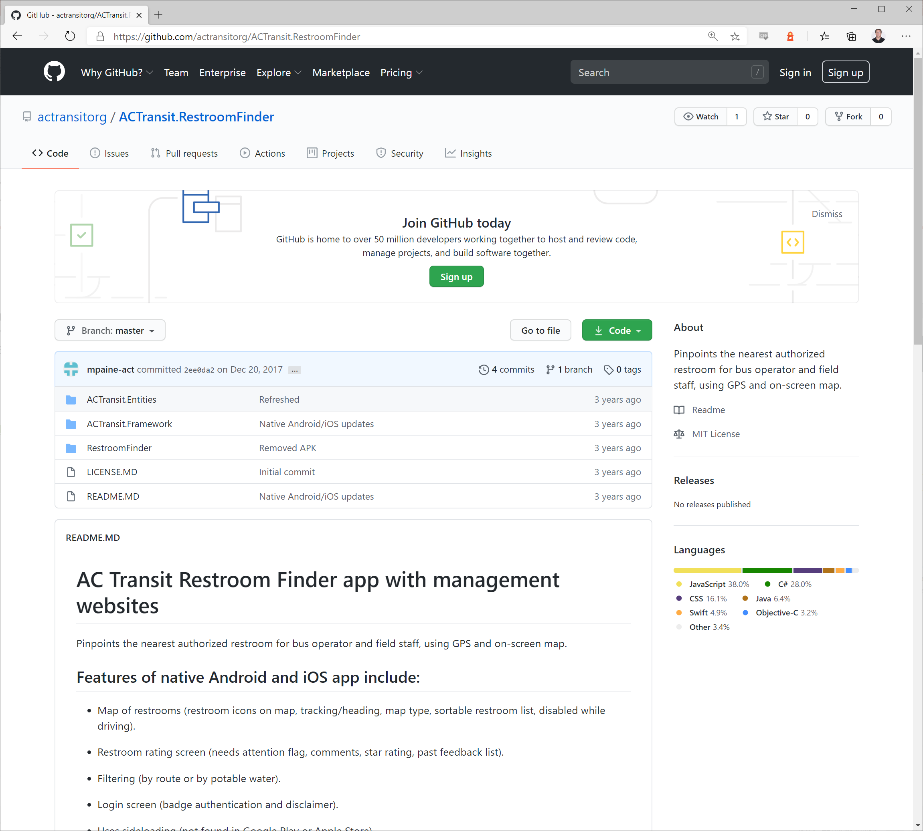
Open Source
Restroom finder application is open-source software, freely available to use without limitation and warranty. Our goal is to launch an intellectual property exchange that reduces cost and maximizes value in the transit industry and beyond. The application source code is available at the GitHub website for agencies, developers, business members to use:
https://github.com/actransitorg/ACTransit.RestroomFinder.

